Slide 1
Amazon RDS for PostgreSQL
Lessons Learned and Deep Dive on New Features
Grant McAlister – Senior Principal Engineer - RDS
April 2016

Slide 2

RDS Version Updates
New Major Version – 9.5.2
New Minor Releases
9.3.12
9.4.7 (default)

Slide 3
Extension Support Additions
recent ip4r, pg_buffercache, pgstattuple
9.5 address_standardizer, address_standardizer_us,
hstore_plperl, tsm_system_rows, tsm_system_time

Slide 4
Extension Support Additions
recent ip4r, pg_buffercache, pgstattuple
9.5 address_standardizer, address_standardizer_us,
hstore_plperl, tsm_system_rows, tsm_system_time
rds-postgres-extensions-request@amazon.com
9.3 Original - 32
9.3 Current - 35
9.4 Current - 39
9.5 Current - 44
Future - ???

Slide 5
9.5 Parameter Changes - Checkpointing
checkpoint_segments=16
checkpoint_timeout=5 min
min_wal_size=256MB & max_wal_size=2GB
checkpoint_timeout=5 min

Slide 6
9.5 Parameter Changes - Checkpointing
checkpoint_segments=16
checkpoint_timeout=5 min
min_wal_size=256MB & max_wal_size=2GB
checkpoint_timeout=5 min

Slide 7
9.5 Parameter Changes - Checkpointing
checkpoint_segments=16
checkpoint_timeout=5 min
Checkpoint after 5 min or 16x16 (256MB)
min_wal_size=256MB & max_wal_size=2GB
checkpoint_timeout=5 min

Slide 8
9.5 Parameter Changes - Checkpointing
checkpoint_segments=16
checkpoint_timeout=5 min
Checkpoint after 5 min or 16x16 (256MB)
min_wal_size=256MB & max_wal_size=2GB
checkpoint_timeout=5 min

Slide 9
9.5 Parameter Changes - Checkpointing
checkpoint_segments=16
checkpoint_timeout=5 min
Checkpoint after 5 min or 16x16 (256MB)
min_wal_size=256MB & max_wal_size=2GB
checkpoint_timeout=5 min
Checkpoint after 5 min or 2GB

Slide 10
9.5 RDS Parameter Default Improvement
rds_superuser_reserved_connections
9.4 Defaults to 0
9.5 Defaults to 2
max_connections
9.3/9.4 {DBInstanceClassMemory/31457280}
9.5 LEAST({DBInstanceClassMemory/9531392},5000)
Higher values for smaller instances but stops at 5000 connections on large instances

Slide 11
max_connections

Slide 12
max_connections

Slide 13
All Version Default Parameter Changes
maintenance_work_mem
Before
9.3 = 16MB
9.4 = 64MB
Now
9.3/9.4/9.5 = GREATEST({DBInstanceClassMemory/63963136*1024},65536)
Minimum of 64MB but now scales with instance size
Only applies to default parameter groups and newly create custom groups

Slide 14
maintenance_work_mem

Slide 15
maintenance_work_mem

Slide 16
Major version upgrade
Prod
9.4
Notes:
Line data type
Reg* data types
Open prepared transactions

Slide 17
Major version upgrade
Prod
9.4
Backup
Notes:
Line data type
Reg* data types
Open prepared transactions

Slide 18
Major version upgrade
Prod
9.4
pg_upgrade
Backup
Notes:
Line data type
Reg* data types
Open prepared transactions

Slide 19
Major version upgrade
Prod
9.4
pg_upgrade
Backup
Backup
Notes:
Line data type
Reg* data types
Open prepared transactions

Slide 20
Major version upgrade
Prod
9.4
Prod
9.5
pg_upgrade
Backup
Backup
Notes:
Line data type
Reg* data types
Open prepared transactions

Slide 21
Major version upgrade
Prod
9.4
Prod
9.5
pg_upgrade
No PITR
Backup
Backup
Notes:
Line data type
Reg* data types
Open prepared transactions

Slide 22
Major version upgrade
Prod
9.4
Notes:
Line data type
Reg* data types
Open prepared transactions

Slide 23
Major version upgrade
Prod
9.4
Restore to a test instance
Test
9.4
Notes:
Line data type
Reg* data types
Open prepared transactions

Slide 24
Major version upgrade
Prod
9.4
Restore to a test instance
Test
9.4
pg_upgrade
Notes:
Line data type
Reg* data types
Open prepared transactions

Slide 25
Major version upgrade
Prod
9.4
Restore to a test instance
Test
9.4
Test
9.5
pg_upgrade
Notes:
Line data type
Reg* data types
Open prepared transactions

Slide 26
Major version upgrade
Prod
9.4
Restore to a test instance
Test
9.4
Test
9.5
Application Testing
pg_upgrade
Notes:
Line data type
Reg* data types
Open prepared transactions

Slide 27
Major version upgrade
Prod
9.4
Restore to a test instance
Test
9.4
Test
9.5
Application Testing
pg_upgrade
Notes:
Line data type
Reg* data types
Open prepared transactions

Slide 28
Major version upgrade
Prod
9.4
Prod
9.5
pg_upgrade
No PITR
Backup
Backup
Restore to a test instance
Test
9.4
Test
9.5
Application Testing
pg_upgrade
Notes:
Line data type
Reg* data types
Open prepared transactions

Slide 29
Security

Slide 30
Forcing SSL on all connections
Snapshot
DB Instance
Application
Host
Log Backups

Slide 31
Forcing SSL on all connections
Snapshot
DB Instance
Application
Host
Security Group
Log Backups

Slide 32
Forcing SSL on all connections
Snapshot
DB Instance
Application
Host
SSL
Security Group
Log Backups

Slide 33
Forcing SSL on all connections
Snapshot
DB Instance
Application
Host
SSL
Security Group
VPC
Log Backups

Slide 34
Forcing SSL on all connections
Snapshot
DB Instance
Application
Host
SSL
Security Group
VPC
Log Backups
Encryption at Rest

Slide 35
Forcing SSL on all connections
Snapshot
DB Instance
Application
Host
SSL
ssl_mode=disable
Security Group
VPC
Log Backups
Encryption at Rest

Slide 36
Forcing SSL on all connections
Snapshot
DB Instance
Application
Host
SSL
ssl_mode=disable
Security Group
VPC
Log Backups
Encryption at Rest

Slide 37
Forcing SSL on all connections
Snapshot
DB Instance
Application
Host
SSL
ssl_mode=disable
Security Group
VPC
Log Backups
Encryption at Rest
rds.force_ssl=1 (default 0)

Slide 38
Forcing SSL on all connections
Snapshot
DB Instance
Application
Host
SSL
ssl_mode=disable
Security Group
VPC
Log Backups
Encryption at Rest
rds.force_ssl=1 (default 0)

Slide 39
Unencrypted Snapshot Sharing
DB Instance
Snapshot
Snapshot
Share to Public
Prod Account
Share with account
DB Instance
Snapshot
Test Account

Slide 40
Encrypted Snapshot Sharing
DB Instance
Snapshot
Prod Account
Test Account
Notes:
Add a Key for the encrypted snapshot and then show that it needs to be shared for this to work. Note that this doesn’t work with default keys.

Slide 41
Encrypted Snapshot Sharing
Encryption at Rest
DB Instance
Snapshot
Default
Prod Account
Test Account
Notes:
Add a Key for the encrypted snapshot and then show that it needs to be shared for this to work. Note that this doesn’t work with default keys.

Slide 42
Encrypted Snapshot Sharing
Encryption at Rest
DB Instance
Snapshot
Snapshot
Default
Prod Account
Share with account
Test Account
Notes:
Add a Key for the encrypted snapshot and then show that it needs to be shared for this to work. Note that this doesn’t work with default keys.

Slide 43
Encrypted Snapshot Sharing
Encryption at Rest
DB Instance
Snapshot
Snapshot
Default
Prod Account
Share with account
Test Account
Notes:
Add a Key for the encrypted snapshot and then show that it needs to be shared for this to work. Note that this doesn’t work with default keys.

Slide 44
Encrypted Snapshot Sharing
Encryption at Rest
DB Instance
Snapshot
Snapshot
Prod Account
Share with account
Test Account
Notes:
Add a Key for the encrypted snapshot and then show that it needs to be shared for this to work. Note that this doesn’t work with default keys.

Slide 45
Encrypted Snapshot Sharing
Encryption at Rest
DB Instance
Snapshot
Snapshot
Custom
Key
Prod Account
Share with account
Test Account
Notes:
Add a Key for the encrypted snapshot and then show that it needs to be shared for this to work. Note that this doesn’t work with default keys.

Slide 46
Encrypted Snapshot Sharing
Encryption at Rest
DB Instance
Snapshot
Snapshot
Custom
Key
Prod Account
Share with account
Add external account
Test Account
Notes:
Add a Key for the encrypted snapshot and then show that it needs to be shared for this to work. Note that this doesn’t work with default keys.

Slide 47
Encrypted Snapshot Sharing
Encryption at Rest
DB Instance
Snapshot
Snapshot
Custom
Key
Prod Account
Share with account
Add external account
Snapshot
Test Account
Notes:
Add a Key for the encrypted snapshot and then show that it needs to be shared for this to work. Note that this doesn’t work with default keys.

Slide 48
Encrypted Snapshot Sharing
Encryption at Rest
DB Instance
Snapshot
Snapshot
Custom
Key
Prod Account
Share with account
Add external account
DB Instance
Snapshot
Test Account
Notes:
Add a Key for the encrypted snapshot and then show that it needs to be shared for this to work. Note that this doesn’t work with default keys.

Slide 49
Encryption at rest overhead

Slide 50
Encryption at rest overhead
No measureable overhead

Slide 51
Encryption at rest overhead

Slide 52
Encryption at rest overhead
5 to 10% Overhead on heavy write

Slide 53
Data movement

Slide 54








Move data to the same or different database engine
Keep your apps running during the migration
Start your first migration in 10 minutes or less
Replicate within, to, or from AWS EC2 or RDS
AWS
Database Migration Service
(DMS)
Notes:
Move data to the same or different database engine
~ Supports Oracle, Microsoft SQL Server, MySQL, PostgreSQL, MariaDB, Amazon Aurora, Amazon Redshift
Keep your apps running during the migration
~ DMS minimizes impact to users by capturing and applying data changes
Start your first migration in 10 minutes or less
~ The AWS Database Migration Service takes care of infrastructure provisioning and allows you to setup your first database migration task in less than 10 minutes
Replicate within, to or from AWS EC2 or RDS
~ After migrating your database, use the AWS Database Migration Service to replicate data into your Redshift data warehouses, cross-region to other RDS instances, or back to on-premises

Slide 55
Keep your apps running during the migration
Customer
Premises
EC2
or
RDS
VPN
Internet
Application Users
Notes:
Using the AWS Database Migration Service to migrate data to AWS is simple.
(CLICK) Start by spinning up a DMS instance in your AWS environment
(CLICK) Next, from within DMS, connect to both your source and target databases
(CLICK) Choose what data you want to migrate. DMS lets you migrate tables, schemas, or whole databases
Then sit back and let DMS do the rest. (CLICK) It creates the tables, loads the data, and best of all, keeps them synchronized for as long as you need
That replication capability, which keeps the source and target data in sync, allows customers to switch applications (CLICK) over to point to the AWS database at their leisure. DMS eliminates the need for high-stakes extended outages to migrate production data into the cloud. DMS provides a graceful switchover capability.

Slide 56

Keep your apps running during the migration
Customer
Premises
EC2
or
RDS
VPN
Internet
AWS Database Migration Service
Start a replication instance
Application Users
Notes:
Using the AWS Database Migration Service to migrate data to AWS is simple.
(CLICK) Start by spinning up a DMS instance in your AWS environment
(CLICK) Next, from within DMS, connect to both your source and target databases
(CLICK) Choose what data you want to migrate. DMS lets you migrate tables, schemas, or whole databases
Then sit back and let DMS do the rest. (CLICK) It creates the tables, loads the data, and best of all, keeps them synchronized for as long as you need
That replication capability, which keeps the source and target data in sync, allows customers to switch applications (CLICK) over to point to the AWS database at their leisure. DMS eliminates the need for high-stakes extended outages to migrate production data into the cloud. DMS provides a graceful switchover capability.

Slide 57
Keep your apps running during the migration
Customer
Premises
EC2
or
RDS
VPN
Internet
AWS Database Migration Service
Start a replication instance
Connect to source and target databases
Application Users
Notes:
Using the AWS Database Migration Service to migrate data to AWS is simple.
(CLICK) Start by spinning up a DMS instance in your AWS environment
(CLICK) Next, from within DMS, connect to both your source and target databases
(CLICK) Choose what data you want to migrate. DMS lets you migrate tables, schemas, or whole databases
Then sit back and let DMS do the rest. (CLICK) It creates the tables, loads the data, and best of all, keeps them synchronized for as long as you need
That replication capability, which keeps the source and target data in sync, allows customers to switch applications (CLICK) over to point to the AWS database at their leisure. DMS eliminates the need for high-stakes extended outages to migrate production data into the cloud. DMS provides a graceful switchover capability.

Slide 58
Keep your apps running during the migration
Customer
Premises
EC2
or
RDS
VPN
Internet
AWS Database Migration Service
Start a replication instance
Connect to source and target databases
Select tables, schemas, or databases
Application Users
Notes:
Using the AWS Database Migration Service to migrate data to AWS is simple.
(CLICK) Start by spinning up a DMS instance in your AWS environment
(CLICK) Next, from within DMS, connect to both your source and target databases
(CLICK) Choose what data you want to migrate. DMS lets you migrate tables, schemas, or whole databases
Then sit back and let DMS do the rest. (CLICK) It creates the tables, loads the data, and best of all, keeps them synchronized for as long as you need
That replication capability, which keeps the source and target data in sync, allows customers to switch applications (CLICK) over to point to the AWS database at their leisure. DMS eliminates the need for high-stakes extended outages to migrate production data into the cloud. DMS provides a graceful switchover capability.

Slide 59
Keep your apps running during the migration
Customer
Premises
EC2
or
RDS
VPN
Internet
AWS Database Migration Service
Start a replication instance
Connect to source and target databases
Select tables, schemas, or databases
Let the AWS Database Migration Service create tables and load data
Application Users
Notes:
Using the AWS Database Migration Service to migrate data to AWS is simple.
(CLICK) Start by spinning up a DMS instance in your AWS environment
(CLICK) Next, from within DMS, connect to both your source and target databases
(CLICK) Choose what data you want to migrate. DMS lets you migrate tables, schemas, or whole databases
Then sit back and let DMS do the rest. (CLICK) It creates the tables, loads the data, and best of all, keeps them synchronized for as long as you need
That replication capability, which keeps the source and target data in sync, allows customers to switch applications (CLICK) over to point to the AWS database at their leisure. DMS eliminates the need for high-stakes extended outages to migrate production data into the cloud. DMS provides a graceful switchover capability.

Slide 60
Keep your apps running during the migration
Customer
Premises
EC2
or
RDS
VPN
Internet
AWS Database Migration Service
Start a replication instance
Connect to source and target databases
Select tables, schemas, or databases
Let the AWS Database Migration Service create tables and load data
Uses change data capture to keep them in sync
Application Users
Notes:
Using the AWS Database Migration Service to migrate data to AWS is simple.
(CLICK) Start by spinning up a DMS instance in your AWS environment
(CLICK) Next, from within DMS, connect to both your source and target databases
(CLICK) Choose what data you want to migrate. DMS lets you migrate tables, schemas, or whole databases
Then sit back and let DMS do the rest. (CLICK) It creates the tables, loads the data, and best of all, keeps them synchronized for as long as you need
That replication capability, which keeps the source and target data in sync, allows customers to switch applications (CLICK) over to point to the AWS database at their leisure. DMS eliminates the need for high-stakes extended outages to migrate production data into the cloud. DMS provides a graceful switchover capability.

Slide 61
Keep your apps running during the migration
Customer
Premises
EC2
or
RDS
VPN
Internet
AWS Database Migration Service
Start a replication instance
Connect to source and target databases
Select tables, schemas, or databases
Let the AWS Database Migration Service create tables and load data
Uses change data capture to keep them in sync
Switch applications over to the target at your convenience
Application Users
Notes:
Using the AWS Database Migration Service to migrate data to AWS is simple.
(CLICK) Start by spinning up a DMS instance in your AWS environment
(CLICK) Next, from within DMS, connect to both your source and target databases
(CLICK) Choose what data you want to migrate. DMS lets you migrate tables, schemas, or whole databases
Then sit back and let DMS do the rest. (CLICK) It creates the tables, loads the data, and best of all, keeps them synchronized for as long as you need
That replication capability, which keeps the source and target data in sync, allows customers to switch applications (CLICK) over to point to the AWS database at their leisure. DMS eliminates the need for high-stakes extended outages to migrate production data into the cloud. DMS provides a graceful switchover capability.

Slide 62
AWS Database Migration Service - PostgreSQL
Source - on premises or EC2 PostgreSQL (9.4+)
Destination can be EC2 or RDS
Initial bulk copy via consistent select
Uses PostgreSQL logical replication support to provide change data capture
https://aws.amazon.com/dms/

Slide 63
Schema Conversion Tool - SCT
Downloadable tool (Windows, Mac, Linux Desktop)
Source Database | Target Database on Amazon RDS
Microsoft SQL Server | Amazon Aurora, MySQL, PostgreSQL
MySQL | PostgreSQL
Oracle | Amazon Aurora, MySQL, PostgreSQL
PostgreSQL | Amazon Aurora, MySQL

Slide 64
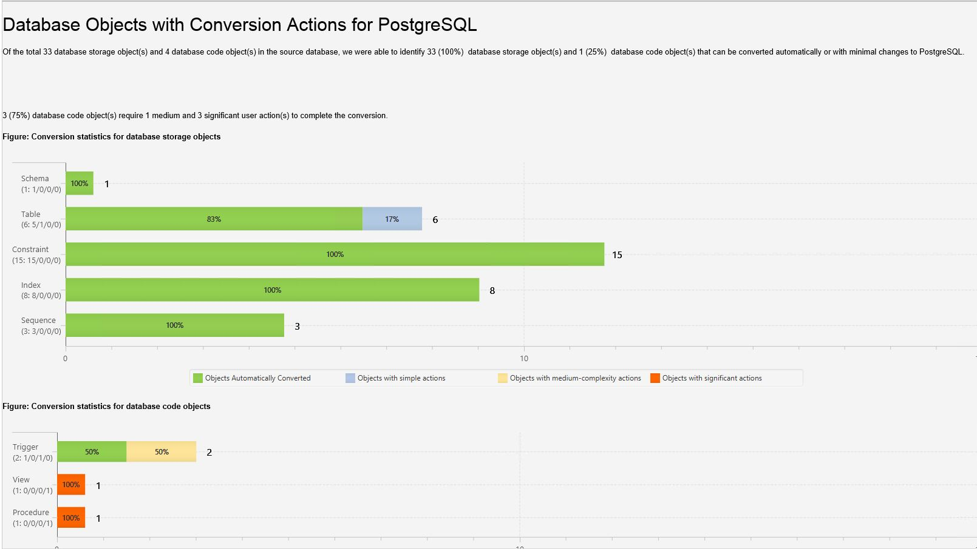
SCT - Analysis

Slide 65
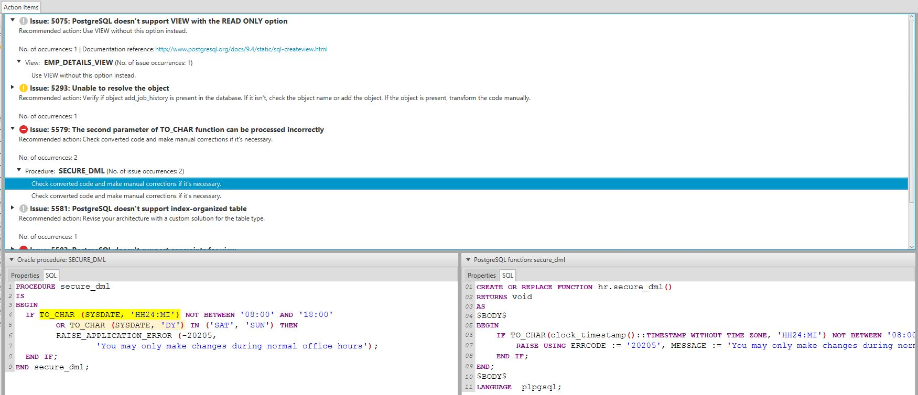
SCT - Detailed

Slide 66
Vacuum parameters
Will auto vacuum when
autovacuum_vacuum_threshold + autovacuum_vacuum_scale_factor * pgclass.reltuples
How hard auto vacuum works
autovacuum_max_workers
autovacuum_nap_time
autovacuum_cost_limit
autovacuum_cost_delay
Transaction ID
Wrap Around

Slide 67
RDS autovacuum logging (9.4.5+)
log_autovacuum_min_duration = 5000 (i.e. 5 secs)
rds.force_autovacuum_logging_level = LOG
…[14638]:ERROR: canceling autovacuum task
…[14638]:CONTEXT: automatic vacuum of table "postgres.public.pgbench_tellers"
…[14638]:LOG: skipping vacuum of "pgbench_branches" --- lock not available

Slide 68
RDS autovacuum visibility(9.3.12, 9.4.7, 9.5.2)
pg_stat_activity
BEFORE
usename | query
----------+-------------------------------------------------------------
rdsadmin | <insufficient privilege>
rdsadmin | <insufficient privilege>
gtest | SELECT c FROM sbtest27 WHERE id BETWEEN 392582 AND 392582+4
gtest | select usename, query from pg_stat_activity
NOW
usename | query
----------+----------------------------------------------
rdsadmin | <insufficient privilege>
gtest | select usename, query from pg_stat_activity
gtest | COMMIT
rdsadmin | autovacuum: ANALYZE public.sbtest16

Slide 69
RDS autovacuum visibility(9.3.12, 9.4.7, 9.5.2)
pg_stat_activity
BEFORE
usename | query
----------+-------------------------------------------------------------
rdsadmin | <insufficient privilege>
rdsadmin | <insufficient privilege>
gtest | SELECT c FROM sbtest27 WHERE id BETWEEN 392582 AND 392582+4
gtest | select usename, query from pg_stat_activity
NOW
usename | query
----------+----------------------------------------------
rdsadmin | <insufficient privilege>
gtest | select usename, query from pg_stat_activity
gtest | COMMIT
rdsadmin | autovacuum: ANALYZE public.sbtest16

Slide 70
RDS autovacuum visibility(9.3.12, 9.4.7, 9.5.2)
pg_stat_activity
BEFORE
usename | query
----------+-------------------------------------------------------------
rdsadmin | <insufficient privilege>
rdsadmin | <insufficient privilege>
gtest | SELECT c FROM sbtest27 WHERE id BETWEEN 392582 AND 392582+4
gtest | select usename, query from pg_stat_activity
NOW
usename | query
----------+----------------------------------------------
rdsadmin | <insufficient privilege>
gtest | select usename, query from pg_stat_activity
gtest | COMMIT
rdsadmin | autovacuum: ANALYZE public.sbtest16

Slide 71
Scale and availability

Slide 72
M4 Instance Class – pgbench read only

Slide 73
Enhanced Operating System (OS) metrics
cpuUtilization
guest
irq
system
wait
idl:
user
total
steal
nice
diskIO
writeKbPS
readIOsPS
await
readKbPS
rrqmPS
util
avgQueueLen
tps
readKb
writeKb
avgReqSz
wrqmPS
writeIOsPS
memory
writeback
cached
free
inactive
dirty
mapped
active
total
slab
buffers
pageTable
Hugepages
processList
name
cpuTime
parentID
memoryUsedPct
cpuUsedPct
id
rss
vss
fileSys
used
usedFiles
usedFilePercent
maxFiles
total
usedPercent
uptime
tasks
sleeping
zombie
running
stopped
total
blocked
swap
cached
total
free
loadAverageMinute
fifteen
five
one
1-60 second granularity

Slide 74
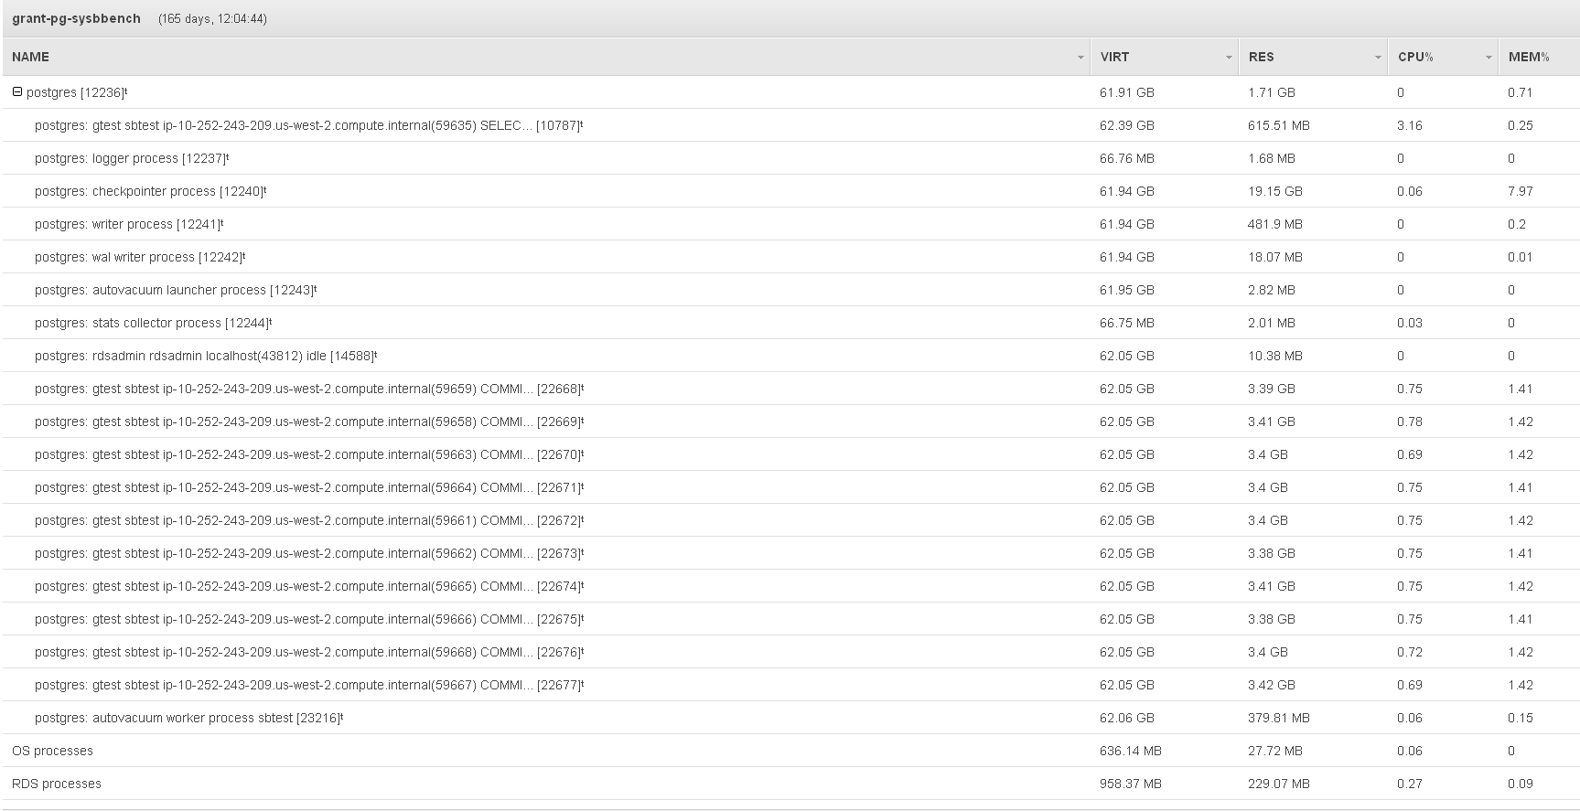
Process List

Slide 75
Process List

Slide 76
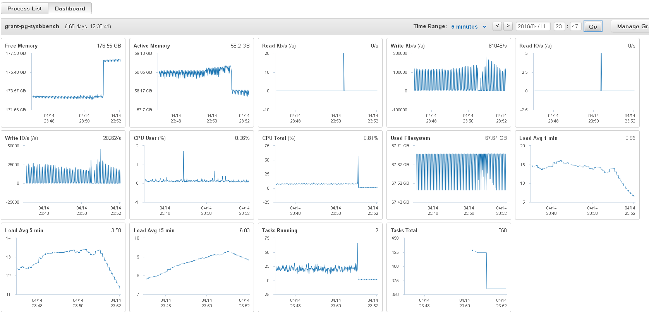
OS metrics

Slide 77
OS metrics

Slide 78
OS metrics

Slide 79
shared_buffers parameter
244GB RAM

Slide 80
shared_buffers parameter
PG processes
244GB RAM

Slide 81
shared_buffers parameter
PG processes
shared_buffers
1/4
244GB RAM

Slide 82
shared_buffers parameter
PG processes
shared_buffers
1/4
Linux
pagecache
244GB RAM

Slide 83
shared_buffers parameter
PG processes
shared_buffers
select of data – check for buffer in shared_buffers
1/4
Linux
pagecache
244GB RAM

Slide 84
shared_buffers parameter
PG processes
shared_buffers
select of data – check for buffer in shared_buffers
1/4
Linux
pagecache
244GB RAM

Slide 85
shared_buffers parameter
PG processes
shared_buffers
select of data – check for buffer in shared_buffers
1/4
Linux
pagecache
if not in shared_buffers load from pagecache/disk
244GB RAM

Slide 86
shared_buffers parameter
PG processes
shared_buffers
select of data – check for buffer in shared_buffers
1/4
Linux
pagecache
if not in shared_buffers load from pagecache/disk
EBS
244GB RAM

Slide 87
shared_buffers parameter
PG processes
shared_buffers
select of data – check for buffer in shared_buffers
1/4
Linux
pagecache
if not in shared_buffers load from pagecache/disk
EBS
244GB RAM

Slide 88
shared_buffers parameter
PG processes
shared_buffers
select of data – check for buffer in shared_buffers
1/4
Linux
pagecache
if not in shared_buffers load from pagecache/disk
shared_buffers = working set size
EBS
244GB RAM

Slide 89
5-6%

Slide 90
3-20%

Slide 91
Availability – Read and Write – Multi-AZ
Application
Primary
AZ1
AZ2

Slide 92
Availability – Read and Write – Multi-AZ
Application
Primary
Secondary
AZ1
AZ2

Slide 93
Availability – Read and Write – Multi-AZ
Application
Application
Primary
Secondary
AZ1
AZ2

Slide 94
Availability – Read and Write – Multi-AZ
Application
Application
Primary
Secondary
AZ1
AZ2
Physical
Synchronous
Replication

Slide 95
Availability – Read and Write – Multi-AZ
Application
Application
Primary
Secondary
AZ1
AZ2
Physical
Synchronous
Replication

Slide 96
Availability – Read and Write – Multi-AZ
Application
Application
Secondary
Secondary
Primary
AZ1
AZ2
Physical
Synchronous
Replication

Slide 97
Availability – Read and Write – Multi-AZ
cname update
DNS
Application
Application
Secondary
Secondary
Primary
AZ1
AZ2
Physical
Synchronous
Replication

Slide 98
Availability – Read and Write – Multi-AZ
cname update
DNS
Application
Application
Primary Update
Secondary
Secondary
Primary
AZ1
AZ2
Physical
Synchronous
Replication

Slide 99
Availability – Read and Write – Multi-AZ
cname update
DNS
Application
Application
Secondary
Primary
AZ1
AZ2
Physical
Synchronous
Replication

Slide 100
Availability – Read and Write – Multi-AZ
cname update
DNS
Application
Application
Secondary
Primary
AZ1
AZ2
Physical
Synchronous
Replication

Slide 101
Availability – Read and Write – Multi-AZ
cname update
DNS
Application
Application
Secondary
Primary
AZ1
AZ2
Physical
Synchronous
Replication

Slide 102
Read Replicas = Availability
Application
Primary
Secondary
Sync
Replication
Multi-AZ

Slide 103
Read Replicas = Availability
Application
Primary
Secondary
Read Replica
Read Replica
Sync
Replication
Multi-AZ
Async Replication

Slide 104
Read Replicas = Availability
Eventually Consistent Reads
Writes & Consistent Reads
Application
Primary
Secondary
Read Replica
Read Replica
Sync
Replication
Multi-AZ
Async Replication

Slide 105
Read Replicas = Availability
Eventually Consistent Reads
Writes & Consistent Reads
Application
Primary
Secondary
Read Replica
Read Replica
Sync
Replication
Multi-AZ
Async Replication

Slide 106
Read Replicas = Availability
Eventually Consistent Reads
Writes & Consistent Reads
Application
Secondary
Primary
Read Replica
Read Replica
Async Replication

Slide 107
Read Replicas = Availability
Eventually Consistent Reads
Writes & Consistent Reads
Application
Secondary
Primary
Read Replica
Read Replica
Async Replication

Slide 108
Read Replicas = Availability
Eventually Consistent Reads
Writes & Consistent Reads
Application
Upgrade
Secondary
Primary
Read Replica
Read Replica
Async Replication

Slide 109
Read Replicas = Availability
Eventually Consistent Reads
Writes & Consistent Reads
Application
Secondary
Primary
Modify
Read Replica
Read Replica
Async Replication

Slide 110
Read Replica promotion
Application
Application
Read Replica
Primary
Secondary
Read Replica
Read Replica
Sync
AZ1
AZ2
AZ3

Slide 111
Read Replica promotion
Application
Application
Read Replica
Primary
Secondary
Read Replica
Read Replica
New Primary
Sync
AZ1
AZ2
AZ3

Slide 112
Read Replica promotion
Application
Application
Application
Read Replica
Primary
Secondary
Read Replica
Read Replica
New Primary
Sync
AZ1
AZ2
AZ3

Slide 113
Replication parameters
Source
A - Foo
Replica
A - Foo

Slide 114
Replication parameters
Source
A - Foo
Replica
A - Foo
Select * from t1

Slide 115
Replication parameters
Source
A - Foo
update t1 set ttext=‘Bar’ where pk=‘A’
Replica
A - Foo
Select * from t1

Slide 116
Replication parameters
Source
A - Foo
update t1 set ttext=‘Bar’ where pk=‘A’
A- Bar
Replica
A - Foo
Select * from t1

Slide 117
Replication parameters
Source
A - Foo
update t1 set ttext=‘Bar’ where pk=‘A’
A- Bar
Replica
A - Foo
Select * from t1

Slide 118
Replication parameters
Source
A - Foo
update t1 set ttext=‘Bar’ where pk=‘A’
A- Bar
Replica
A - Foo
Select * from t1
A- Bar

Slide 119
Replication parameters
Source
A - Foo
update t1 set ttext=‘Bar’ where pk=‘A’
A- Bar
vacuum t1
Replica
A - Foo
Select * from t1
A- Bar

Slide 120
Replication parameters
Source
A - Foo
update t1 set ttext=‘Bar’ where pk=‘A’
A- Bar
vacuum t1
Replica
A - Foo
Select * from t1
A- Bar

Slide 121
Replication parameters
Source
A - Foo
update t1 set ttext=‘Bar’ where pk=‘A’
A- Bar
vacuum t1
Replica
A - Foo
Select * from t1
A- Bar

Slide 122
Replication parameters
Source
A - Foo
update t1 set ttext=‘Bar’ where pk=‘A’
A- Bar
vacuum t1
Replica
A - Foo
FATAL: terminating connection due to conflict with recovery
A- Bar

Slide 123
Replication parameters
Source
A - Foo
update t1 set ttext=‘Bar’ where pk=‘A’
A- Bar
vacuum t1
Replica
A - Foo
FATAL: terminating connection due to conflict with recovery
A- Bar
vacuum_defer_cleanup_age
max_standby_archive_delay
max_standby_streaming_delay
hot_standby_feedback

Slide 124
hot_standby_feedback
wal archive apply
xlog1
Primary
Read Replica
Streaming Replication

Slide 125
hot_standby_feedback
replica conf file
off by default
wal archive apply
xlog1
Primary
Read Replica
Streaming Replication

Slide 126
hot_standby_feedback
replica conf file
off by default
wal archive apply
xlog1
Primary
Read Replica
Streaming Replication

Slide 127
hot_standby_feedback
replica conf file
off by default
wal archive apply
xlog1
Primary
Read Replica
select * from t1
Streaming Replication

Slide 128
hot_standby_feedback
replica conf file
off by default
wal archive apply
xlog1
Primary
Read Replica
select * from t1
select * from t1
Streaming Replication

Slide 129
hot_standby_feedback
replica conf file
off by default
wal archive apply
xlog1
AV
Read Replica
Primary
select * from t1
select * from t1
Streaming Replication

Slide 130
hot_standby_feedback
replica conf file
off by default
wal archive apply
xlog1
AV
Read Replica
Primary
select * from t1
select * from t1
Streaming Replication

Slide 131
hot_standby_feedback
replica conf file
off by default
wal archive apply
xlog1
AV
Read Replica
Primary
select * from t1
select * from t1
Streaming Replication

Slide 132
hot_standby_feedback
replica conf file
off by default
wal archive apply
xlog1
AV
Read Replica
Primary
select * from t1
select * from t1
Streaming Replication

Slide 133
hot_standby_feedback
replica conf file
off by default
wal archive apply
xlog1
AV
Read Replica
Primary
select * from t1
select * from t1
Streaming Replication

Slide 134
hot_standby_feedback
replica conf file
off by default
wal archive apply
xlog1
AV
Read Replica
Primary
select * from t1
select * from t1
max_standby_archive/streaming_delay
Streaming Replication

Slide 135
pg_stat_database_conflicts
benchdb=> select * from pg_stat_database_conflicts;
datid | datname | confl_tablespace | confl_lock | confl_snapshot | confl_bufferpin | confl_deadlock
-------+-----------+------------------+------------+----------------+-----------------+----------------
12891 | template0 | 0 | 0 | 0 | 0 | 0
16384 | rdsadmin | 0 | 0 | 0 | 0 | 0
1 | template1 | 0 | 0 | 0 | 0 | 0
12896 | postgres | 0 | 0 | 0 | 0 | 0
16394 | benchdb | 0 | 0 | 0 | 0 | 0
32810 | bench2 | 0 | 0 | 1 | 0 | 0

Slide 136
Burst mode: GP2 and T2
T2 – Amazon EC2 instance with burst capability
Base performance + burst
Earn credits per hour when below base performance
Can store up to 24 hours worth of credits
Amazon CloudWatch metrics to see credits and usage
GP2 – SSD-based Amazon EBS storage
3 IOPS per GB base performance
Earn credits when usage below base
Burst to 3000+ IOPS

Slide 137
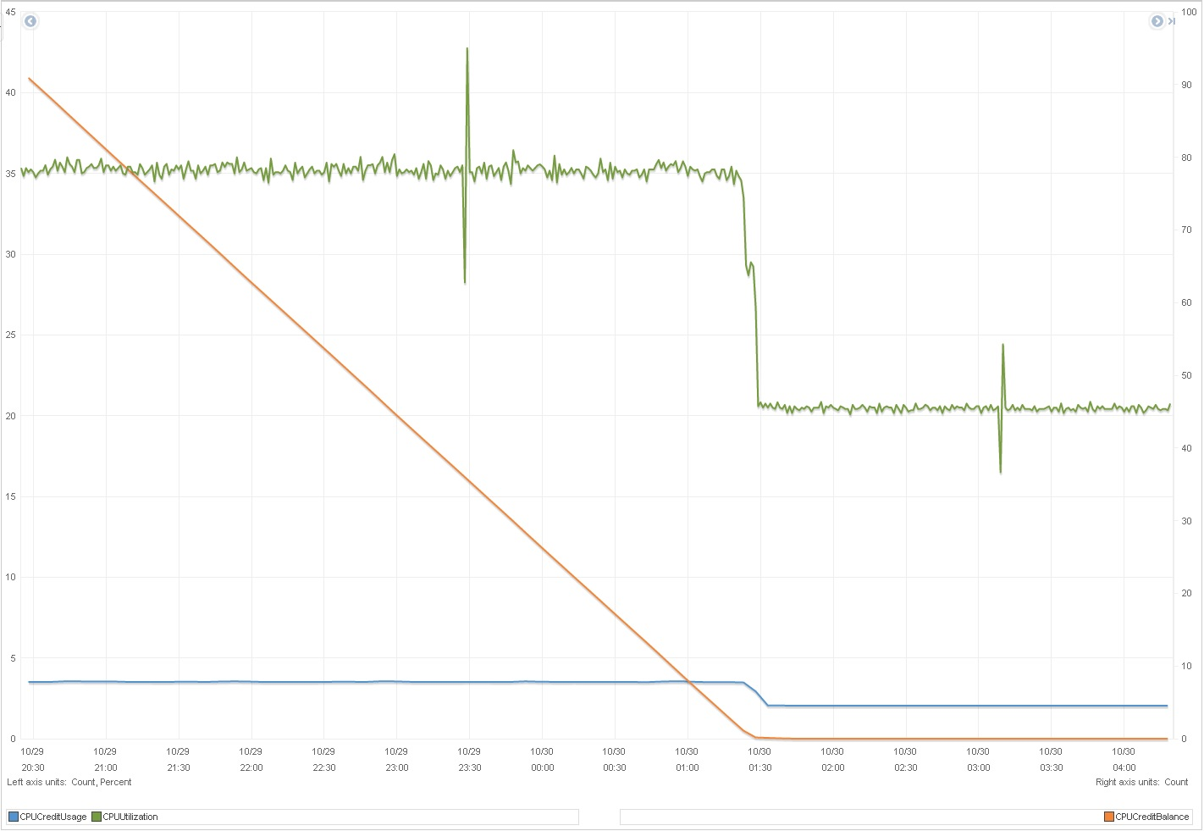
T2 – CPU credits
T2 exhaust CPU credits
CPU credit balance

Slide 138
Burst mode: what’s new
db.t2.large
60 CPU Initial Credit
36 CPU Credit earned per hour
Base Performance – 60%
8 GB RAM
Increased IO bandwidth
Encryption at rest support

Slide 139
Burst mode vs. classic vs. Provisioned IOPS
$0.58 per hour

Slide 140
Burst mode vs. classic vs. Provisioned IOPS
$0.40 per hour
$0.58 per hour

Slide 141
Burst mode vs. classic vs. Provisioned IOPS
$0.50 per hour
$0.40 per hour
$0.58 per hour

Slide 142
Burst mode vs. Classic vs. Provisioned IOPS
$0.50 per hour
$0.40 per hour
$0.58 per hour
$0.10 per hour

Slide 143
Burst mode vs. Classic vs. Provisioned IOPS
$0.50 per hour
$0.40 per hour
$0.58 per hour
$0.10 per hour

Slide 144
Burst mode vs. Classic vs. Provisioned IOPS
$0.23 per hour
$0.50 per hour
$0.40 per hour
$0.58 per hour
$0.10 per hour

Slide 145
Burst mode vs. Classic vs. Provisioned IOPS
$0.23 per hour
$0.50 per hour
$0.40 per hour
$0.58 per hour
$0.10 per hour

Slide 146
Burst mode vs. Classic vs. Provisioned IOPS
$0.30 per hour
$0.23 per hour
$0.50 per hour
$0.40 per hour
$0.58 per hour
$0.10 per hour

Slide 147
Questions?

